Slide 1
FLIGHTS DATA ANALYSIS USING PYTHON
(Pandas, NumPy, Matplotlib, Seaborn)
~Sathwika kurma

Slide 2
INTRODUCTION
The dataset of 301,206 flight bookings from Delhi to Mumbai presents a fascinating opportunity to delve into the intricacies of the aviation industry. This data analysis aims to uncover hidden patterns, trends, and correlations within the data, providing actionable insights that can inform business decisions and enhance operational efficiency.

Slide 3
ABSTRACT
In this report, we will present our findings and insights from the EDA, including visualizations and statistical summaries of the data. We will explore the distribution of ticket prices, analyze the impact of various factors such as departure time, airline, and class of travel on prices, and identify trends and patterns in passenger behavior. Our goal is to provide actionable insights that can help stakeholders in the aviation industry make informed decisions and improve their business outcomes.

Slide 4
DATA SET
The dataset is related to flight bookings, with 301206 rows and 13 columns.
Key insights:
The dataset contains information about flights, including airline, flight number, source city, departure time, stops, and more.
There are multiple airlines, with varying numbers of flights.
Departure times are spread across different times of the day.
Most flights have zero stops, but some have one stop.
The dataset also includes information about arrival times, destination cities, classes, durations, and prices.

Slide 5
OBJECTIVES
The objective of this project is to perform exploratory data analysis (EDA) on this dataset to uncover patterns, trends, and insights that can inform business decisions in the aviation industry. Through this analysis, we aim to identify key factors that influence ticket prices, understand passenger behavior, and provide recommendations to airlines and travel agencies to optimize their operations and improve customer satisfaction.

Slide 6
Methodology
Loading the data: Reading the data from a CSV file into a pandas DataFrame.
Data Cleaning: Handling missing values, correcting data types, and removing any unnecessary columns.
Data Visualization: Using libraries like matplotlib and seaborn to create visualizations that help understand the distributions and relationships within the data.
Summary Statistics: Generating descriptive statistics for numerical and categorical columns.

Slide 7
Potential Analysis Directions
Analyze the distribution of flights by airline, departure time, and destination.
Investigate the relationship between flight duration, price, and class.
Examine the trend of bookings over time, including peak booking periods and days of the week.
Identify the most popular routes and airlines, and analyze their pricing strategies.
Explore the impact of stops on flight duration and price.

Slide 8
Limitations
The dataset only contains information about flights to Mumbai, which may not be representative of the entire flight market.
The dataset does not include information about passenger demographics, which could be useful for targeted marketing and revenue management.
The dataset only covers a limited time period, which may not capture seasonal or annual trends in flight bookings.

Slide 9
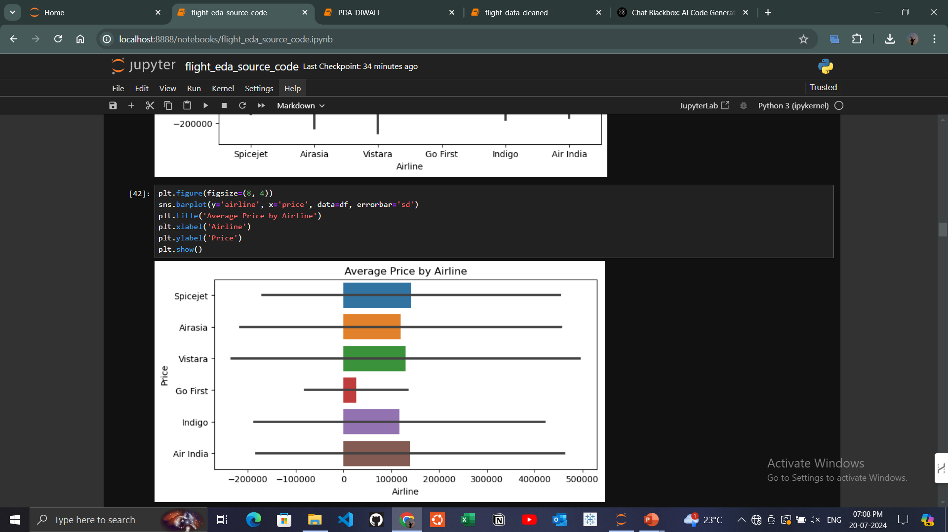
Results
This image shows about the average prices of flight tickets by airlines.
And noticed that Spice jet and Air India have topmost average ticket prices.

Slide 10
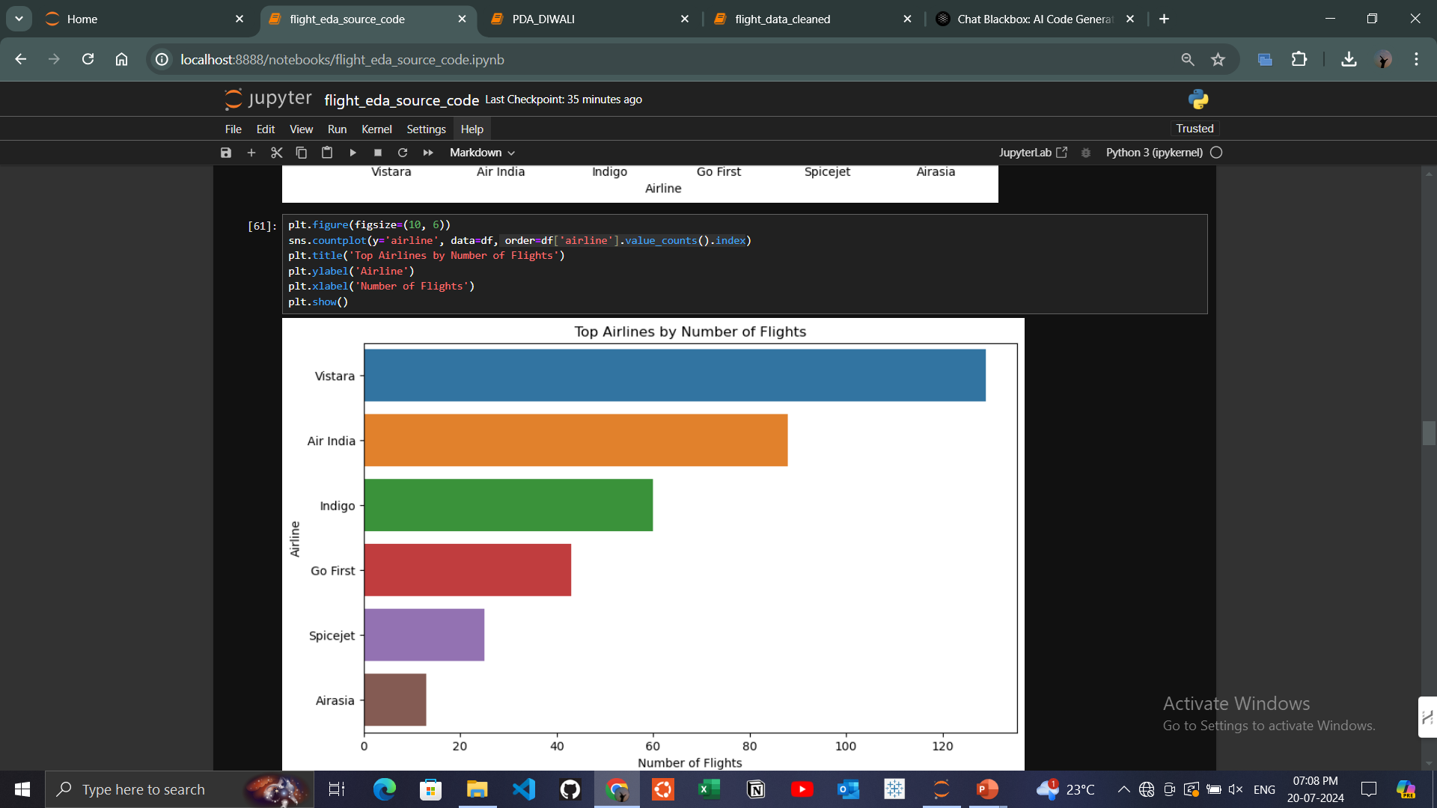
Here the image shows the TOP airlines with the number of flights.
Top 1 is VISTARA airline
Top 2 is AIR INDIA airline

Slide 11
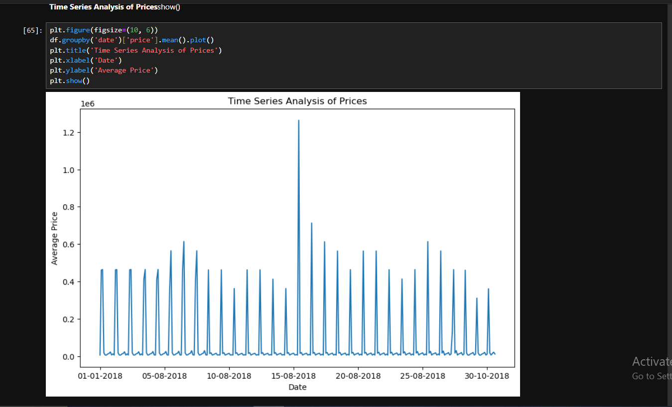
Here is the Time Series analysis of ticket price with respect to the date of time .
We can say that the price of the tickets was high at the time of 15-08-2018 to 20-08-2018

Slide 12
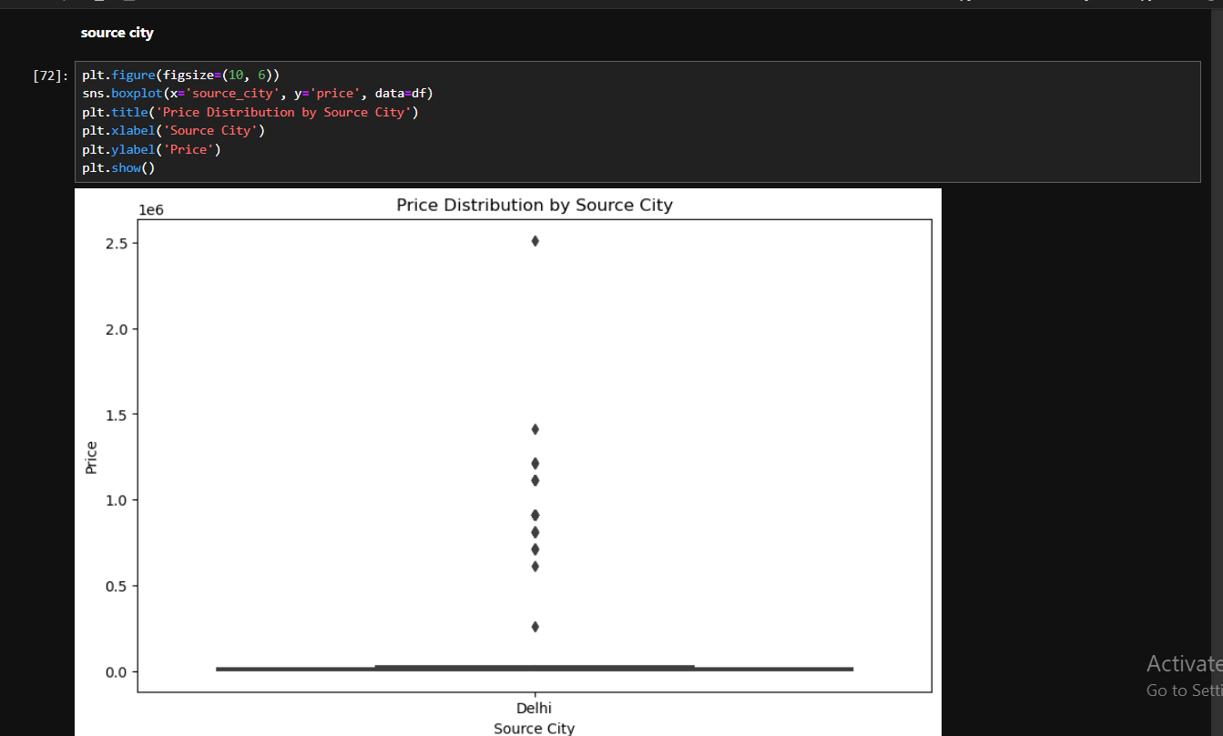
This is the box plot of source cities
The thing concerning here is that it has provided only one city i.e DELHI as source city.

Slide 13
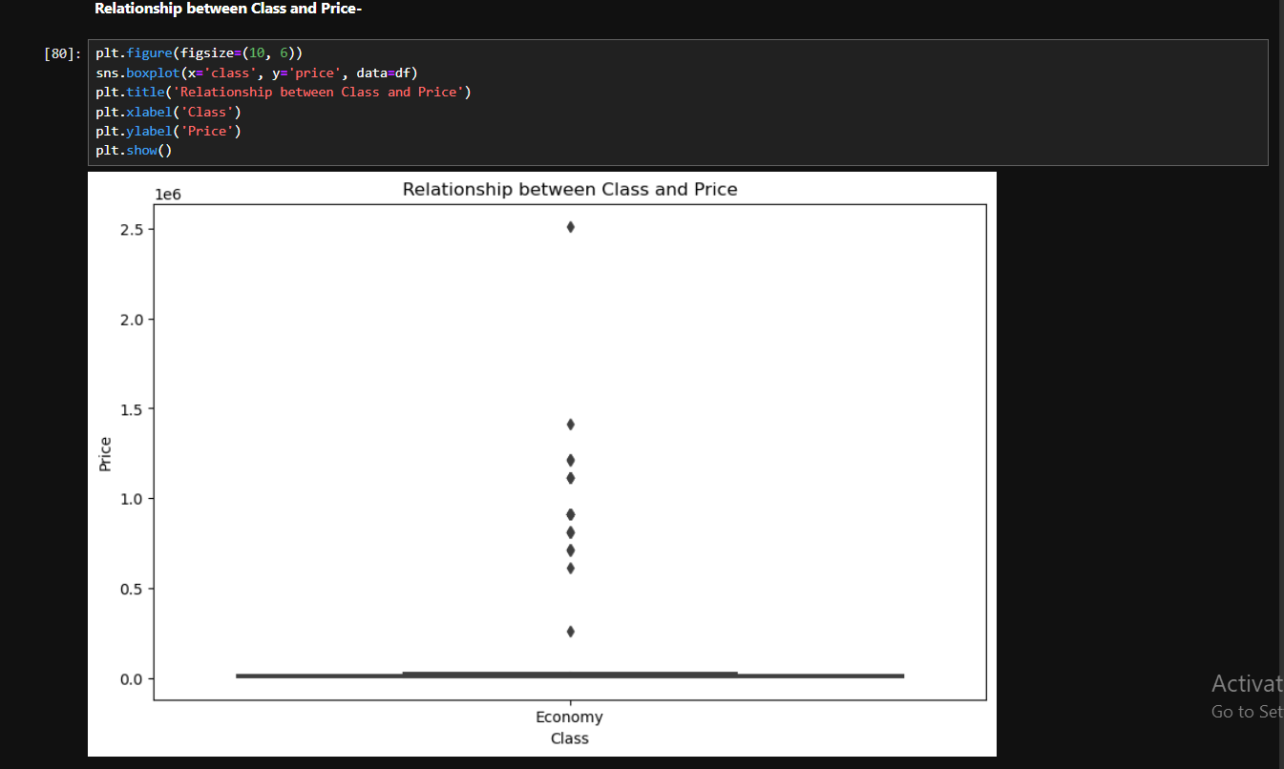
This is the box plot of relationship between class and price
The thing concerning here is that it has provided only one class i.e ECONOMY as class.

Slide 14
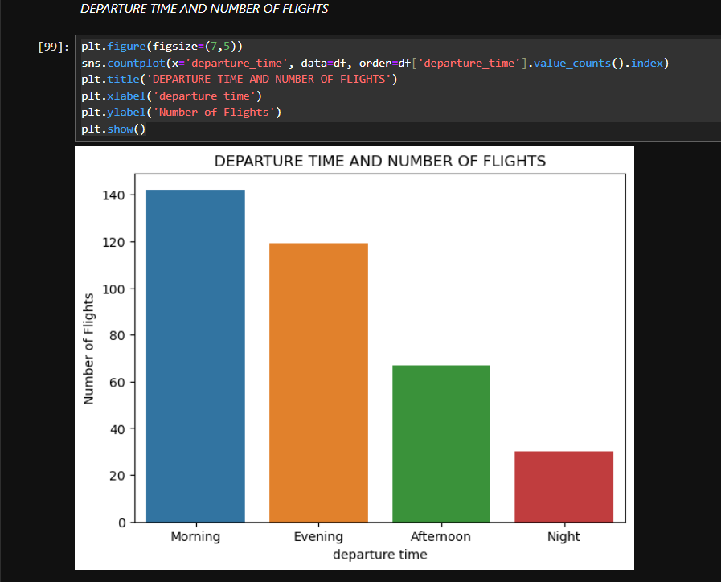
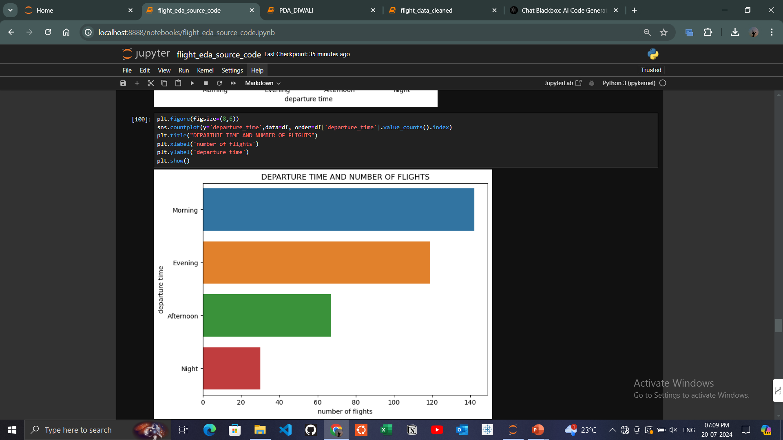
This shows about the departure time and number of flights.
Highest number of flights were of MORNING departure.

Slide 15
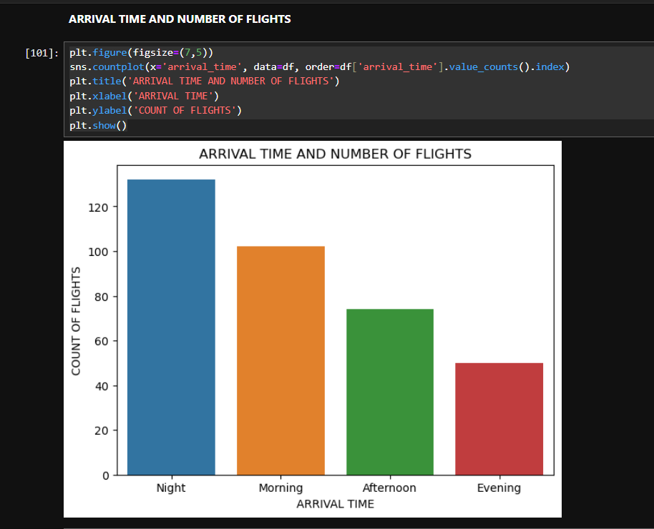
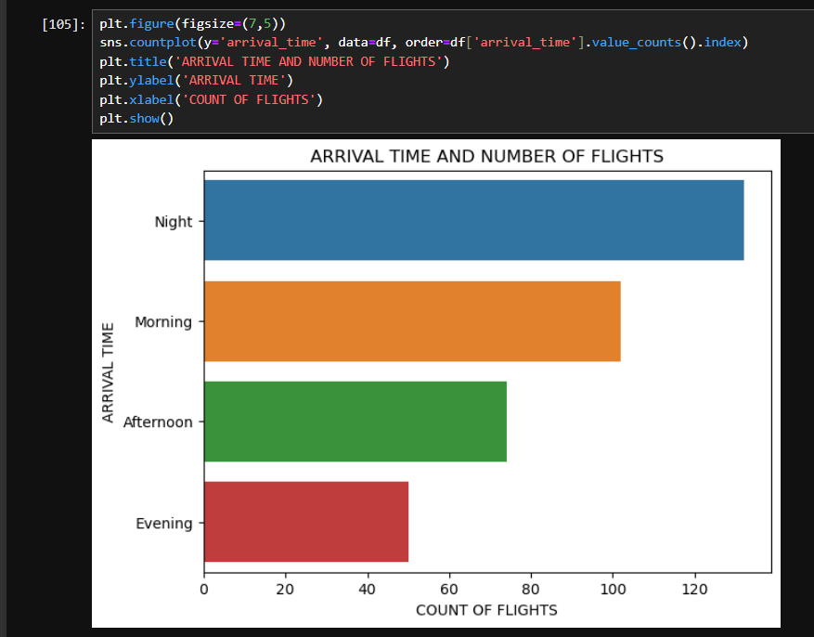
This shows about the arrival time and number of flights.
Highest number of flights were of NIGHT arrival.

Slide 16
DISCUSSION
Top Airlines: Vistara is the top airline with the highest number of flights, followed by Air India.
Price Peaks: The average price of flight tickets was highest between 15-08-2018 to 20-08-2018.
Class: All flights were in the Economy class.
Stops: Most flights have zero stops, but some have one stop.
Cities: The source city for all flights is Delhi, and the destination city is Mumbai
Days Left: The highest number of flights are scheduled with 1 day left until departure.
Flight Duration: Flight UK-977 is noted as having the highest duration among all flights.
Arrival Times: Most flights arrived at night, followed by morning, afternoon, and evening.
Departure Times: Most flights departed in the morning, followed by evening, afternoon, and night
Ticket Prices: The maximum ticket price was 2,512,780, and the minimum ticket price was 5,949.

Slide 17
CONCLUSION
By applying data analysis techniques to this comprehensive dataset, this study aims to provide a deeper understanding of the complex dynamics driving the aviation industry, ultimately informing data-driven decisions that can improve customer satisfaction, increase revenue, and enhance operational efficiency.

Slide 18
THANK YOU

